Slide 1
Digital Portfolio
STUDENT NAME: J.PARAMESHWARAN
REGISTER NO AND NMID24H309/NM:118B3B51B7C6B2BB4B44018D7B399938
DEPARTMENT: BCA
COLLEGE: AGURCHAND MANMULL JAIN COLLEGE

Slide 2
PROJECT TITLE
INTERACTIVE DIGITAL PORTFOLIO USING FRONT END DEVELOPMENT

Slide 3


AGENDA
Problem Statement
Project Overview
End Users
Tools and Technologies
Portfolio design and Layout
Features and Functionality
Results and Screenshots
Conclusion
Github Link
3/21/2024 Annual Review

Slide 4

PROBLEM STATEMENT
Traditional resumes and static portfolios often fail to engage viewers and effectively showcase an individual’s skills. There is a need for an interactive digital portfolio built using front-end technologies (HTML, CSS, JavaScript) that is responsive, visually appealing, and user-friendly, allowing individuals to present their skills, projects, and contact information in a more engaging way.

Slide 5

PROJECT OVERVIEW The project “Interactive Digital Portfolio using Front-End Development” focuses on creating a responsive and user-friendly web-based portfolio to showcase an individual’s profile, skills, projects, and contact details. Using front-end technologies like HTML, CSS, and JavaScript, the portfolio will provide an engaging interface with smooth navigation and interactive features. It aims to replace traditional static resumes with a modern, digital platform that enhances personal branding and accessibility across devices.

Slide 6

WHO ARE THE END USERS? 1. Students & Job Seekers – who use the portfolio to showcase their skills, projects, and achievements to recruiters. 2. Recruiters & Employers – who view the portfolio to evaluate the candidate’s abilities, creativity, and technical expertise. 3. Freelancers & Professionals – who present their work to potential clients or collaborators. 4. Educators & Peers – who may review the portfolio for academic, mentoring, or networking purposes.

Slide 7

TOOLS AND TECHNIQUES TOOLS: HTML5 – for structuring the web pages and content. CSS3 – for styling, layout design, and responsiveness. JavaScript – for adding interactivity and dynamic features. Code Editor (VS Code / Sublime Text) – for writing and managing code. Version Control (Git) – for managing code versions and hosting the portfolio online. TECHNIQUES: Responsive Web Design– to ensure compatibility across devices (desktop, tablet, mobile). Flexbox and Grid Layouts – for modern, flexible page structuring. DOM Manipulation with JavaScript – to make the site interactive. Form Handling – for creating a functional contact section. Smooth Navigation & Animations – to improve user experience and engagement.

Slide 8
POTFOLIO DESIGN AND LAYOUT
POTFOLIO:
Header/Nav Bar – links to Home, About, Skills, Projects, Contact.
Home – introduction with name, tagline, and banner.
About – personal details, education, and profile photo.Skills – technical skills shown using progress bars or cards.
Projects – sample projects in a grid layout with descriptions.
Contact – form and social media links.
Footer – copyright and quick links.
LAYOUT STYLE:
Grid and Flexbox for responsive structuring.
Consistent color scheme (2–3 main colors for branding).
Readable typography with hierarchy (headings, subheadings, body text).
Interactive elements (hover effects, smooth scrolling, animations).
8

Slide 9
FEATURES AND FUNCTIONALITY Responsive Design – Works smoothly on desktop, tablet, and mobile. Navigation Bar – Easy movement between Home, About, Skills, Projects, and Contact. Interactive UI – Hover effects, smooth scrolling, and animations. Skills Section – Visual display of coding and technical skills. Projects Showcase – Grid layout with descriptions and links. Contact Form – Allows users to send queries directly. Social Media Integration – Links to GitHub, LinkedIn, etc. Clean Layout – Simple, modern, and user-friendly design.

Slide 10
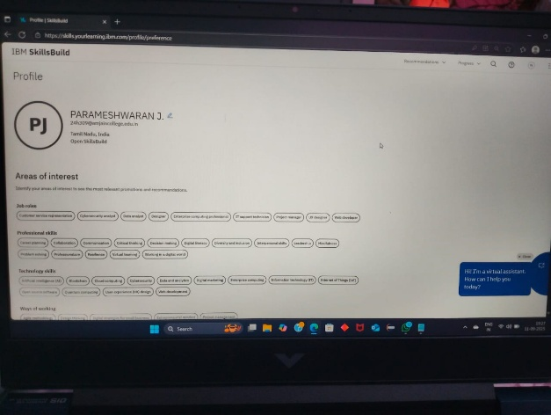
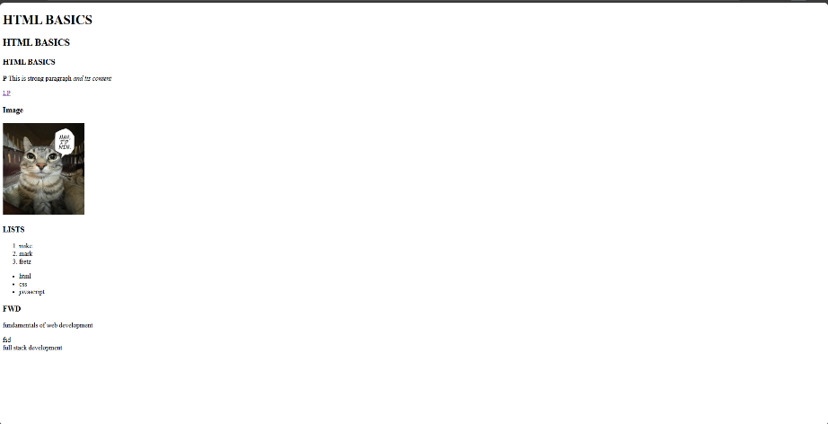
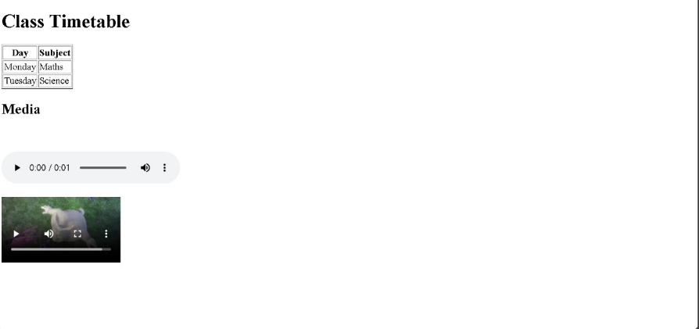

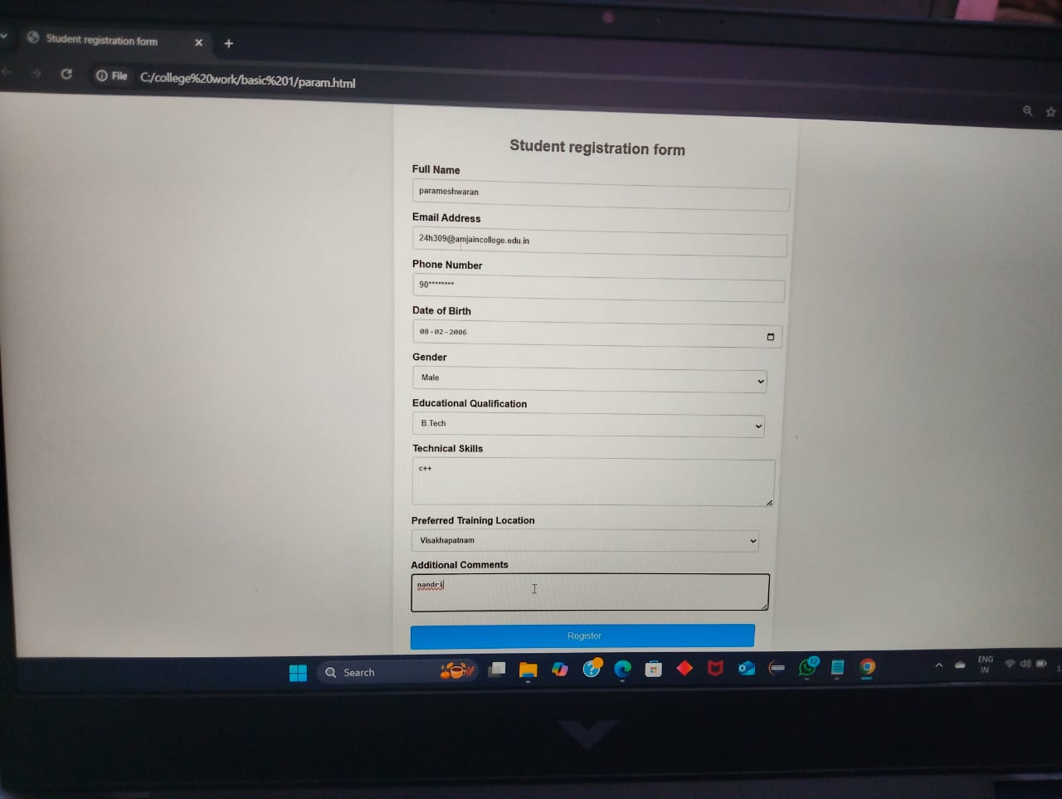
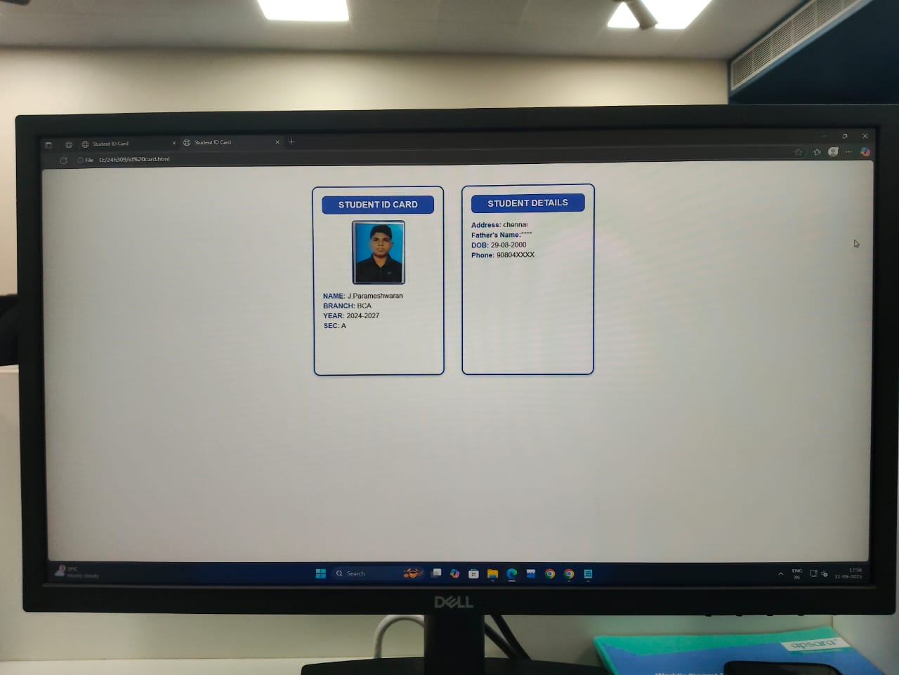
RESULTS AND SCREENSHOTS
3/21/2024 Annual Review
10

Slide 11
CONCLUSION The project “Interactive Digital Portfolio using Front-End Development” successfully demonstrates how modern web technologies like HTML, CSS, and JavaScript can be used to build a responsive, user-friendly, and engaging portfolio. Unlike traditional resumes, this portfolio provides an interactive platform to showcase personal details, skills, and projects in a professional manner. It enhances personal branding, improves accessibility across devices, and serves as an effective tool for students, job seekers, and professionals to present their capabilities to recruiters and clients.
11

